Slide 1
Data Visualization: Chart Selection Guidelines

Slide 2
Overview
Choosing the right visualization is one of the first steps towards making the data story well received by everyone.
This presentation is intended to be used like a tool with guidelines on selecting the right visualization for your dashboard.
While primarily meant for data visualization developers to use during report/dashboard design, it can also be used as a handy reference by Business Analysts (BAs), Architects, Project Managers / Leads, Sales Teams to learn, find, and propose charting designs.
Contents:
About Data Stories
Chart Selection Process
Coloring Guidelines
Charts Reference

Slide 3
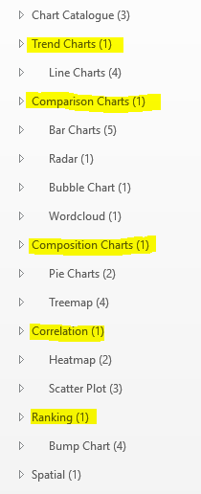
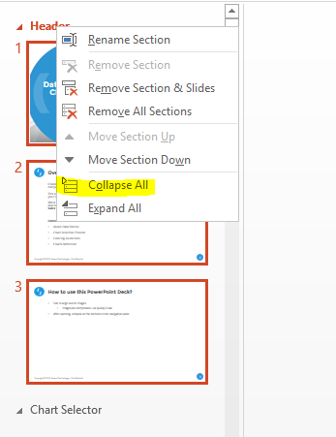
How to use this PowerPoint Deck?
File size is large due to images
Images are compressed – so quality is low
After opening, collapse all the sections in the navigation pane
Then jump to any required section
Ensure you go through the next section (Chart Selector) before using this deck for first time

Slide 4
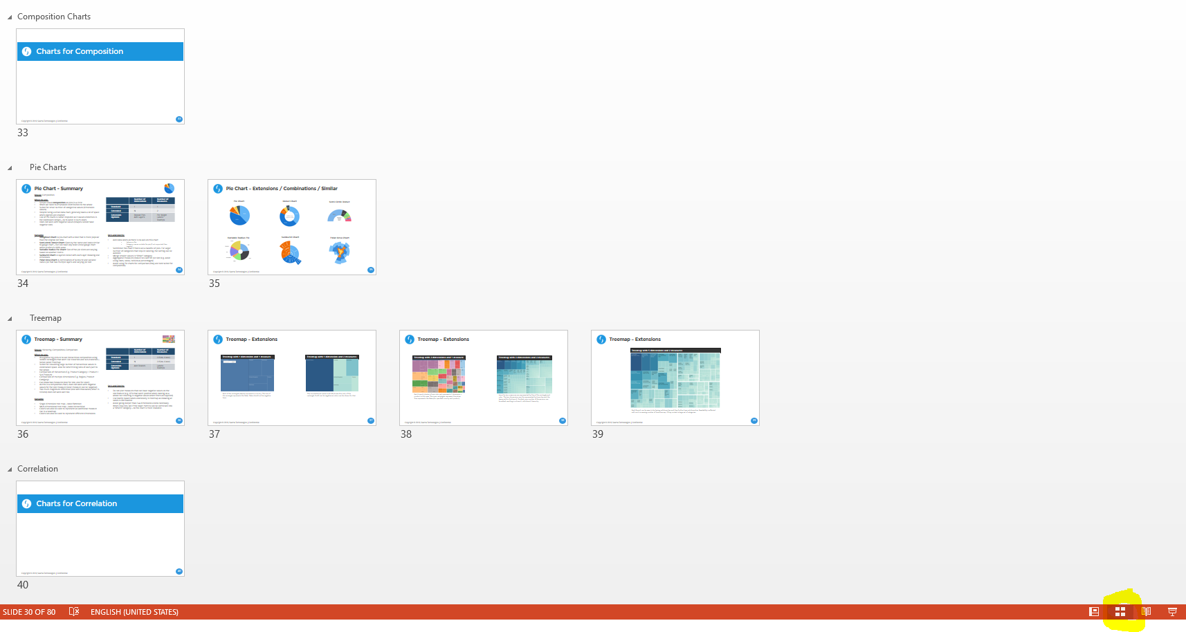
Easy way to view all charts in this deck.. Use Slide Sorter

Slide 5
Data Stories
Dashboards are built to tell data stories
Business facts and secrets lie in Data
Summarized patterns in data relate to form a story
A chart can tell a chapter or part of the story
All the chapters combined make the story complete
A Dashboard is not a report that shows just facts. Stories are integral for the successful adoption of dashboards.
Note: Dashboard Design starts with user interactions to understand their requirements – mostly the business problems they are trying to solve. These inputs are then consolidated to form a story. The purpose of this tool starts after that initial story is understood.

Slide 6
Chart Selector

Slide 7
How to use this tool?
4 steps to chart selection
Step 1: Know your Data
Step 2: Purpose of the Chart
Step 2: Number of Dimensions and Measures
Step 4: Any other criteria (customer, business, data)
Select the chart meeting these criteria
Put the pieces together in a wireframe to see if the result
Looks good (layout, uniformity, size)
Is usable (by business users)
Tells the required data story, and
Feasible to develop in the selected tool
Notes:
Convert this slide into infographic

Slide 8
Step 1: Know your Data
Knowing the data is the first step towards making a data story
Understanding Business functional, Data model, User expectations are key to developing good stories.
Perform some exploratory analysis to get a better understanding of the data forehand (rather than seeing the same thing after developing the dashboard).
This tool can be used before or after wireframing – whenever a chart needs to be selected
The nature of data values in Dimensions and Measures also play a crucial role in chart rendering. Their values may become a factor in chart or visual selection.
Nature of data in dimensions and measures
Whether the measure values are aggregable or not
Whether negative values are present
Are they better used only when sorted/ordered
Data is at different grains
Data latencies may be different
Some compatibility gaps with other charts may be apparent etc.
Data values impacting aesthetics
Number of categorical values in dimensions: Some charts may be good at rendering only a small number of categories
Length of the individual data elements in dimensions: Some charts may not look when showing large names in legend, axes, labels etc.

Slide 9
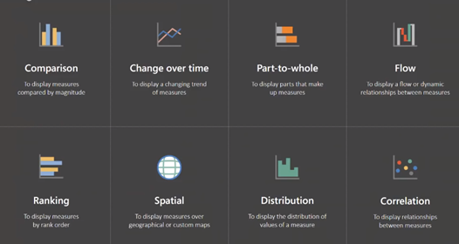
Step 2: Purpose of the Chart
This step is very critical – and is highly influenced based on your business and data understanding. Without knowing the data, you might just easily select the wrong visual type.
Charts aggregate / summarize data visually to show composition, comparison, data distribution, trend etc.
Following are some categories of charts. Some chart may be categorized in multiple categories.
Commonly used
Comparison
Composition
Correlation
Trend
Spatial
Not so commonly used
Distribution
Hierarchy
Ranking
Flow
Calendar

Slide 10
Step 3: Number of Dimensions and Measures
A chart can show a limited number of Dimensions, Measures, and Details.
Also, the number of categorical values in a dimension also impact chart rendering
The number of dimensions and measures can be extended using additional features. These allow the chart to be extended beyond the standard design.
Dual-axis
Stacking
Labels
Tooltips
If the number of dimensions and measures to be shown in very critical, then do adhere to this rule.
Notes:
Optionally, use the chart selector excel to filter out charts that meet your criteria. This excel has not been updated since the PPT version is very detailed and exhaustive.
https://docs.google.com/spreadsheets/d/1nbk7DWTrO3ax-XaK5x-3P3RER4N5xj8i4IXyOAMYm4c/edit#gid=0
The sheet allows filtering based on standard count as well as extended count
Extended count of “N” means 3-5 (and not unlimited)
E.g. Technically, any number of measures can be shown in a Tableau Tooltip – but that would not make much sense.

Slide 11
Step 4: Any other criteria (customer, business)
Users may have some thoughts which may not fit in the definition of our chart selection
Generally they are around the overall story – which may require some extended features such as drill-downs, tooltips, related reports etc.
They may want certain specific rules to be applied – for coloring, grouping, wrapping text, printing etc.
Either re-selection, alteration, or user education can be the approach here.
As a designer / developer, you may have certain constraints or issues – in story, layout, data – which would require a different visual than the one selected.
This tool is a “guideline” and not a “rule” – use best judgment and leverage your experience to work around the constraints.
Moreover, there are numerous types of charts and documenting or categorizing every single one of them is not feasible. Most common charts in this deck will solve 80% of the visualization scenarios.

Slide 12
Coloring Guidelines

Slide 13
Color Guidelines
Color theme is one of the most critical aspects of dashboard design and the first impression is a lot dependent on color. While there are many approaches from UX expert involvement to iterations, here are some important ones to follow in general:
Ask for the customer’s Branding Guidelines for the templates, logos, fonts, colors to be used. Always refer the color palette adhering to corporate norms unless explicitly asked to divert or if the palette does not serve or meet it’s purpose or when a refreshed design is needed.
Always set the color palette in the reporting tool once and make it available to all users (either via server configuration or via a standard reusable report template).
Avoid too many fancy or loud color designs. Prefer subtle and long lasting designs as it will be used in many reports – not just one.
When using a color theme for specific chart, ensure the same is followed for rest of the charts to maintain uniformity.
E.g. Representing Bicycles product in Blue color in one stacked bar chart and then using a different color for Bicycles in a pie chart in the same report will lead to confusion or wrong interpretation (esp. when printed/exported without labels/legend).
Anything in excess is not good – too many colors on a Dashboard or in a chart may not also look good. Either among charts or within the chart – limit the use of colors.

Slide 14
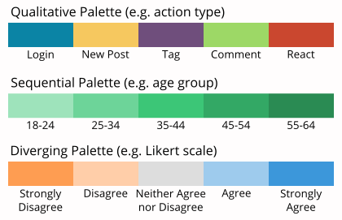
Color Guidelines
Chart Colors are of three types:
Discrete Colors: Each category value is represented by a discretely visible color (e.g. stacks in a stacked bar chart)
Sequential Colors: Single color with dark/light shades generally used for measures (e.g. Sales in a simple bar chart)
Diverging Colors: A diverging set between two colors. Generally used for ranges representing negative/bad to positive/good scale (e.g. CSAT survey, Sales Percentage)
Notes:
Make this slide visual (vertical, with example charts)

Slide 15
Related Tools / Aids
Color Calculator:
This is a good tool for creating custom color palettes (2-4 colors) in case branding guidelines are not available from the customer
It can also be used to find matching colors on RGB tones for any input color we specify
Simple to use – just input the color you have and it will show related colors to use
https://www.sessions.edu/color-calculator/
Example: https://www.sessions.edu/color-calculator-results/?colors=ffcf91,a091ff,ff91f0,f0ff91
Wireframe Tools
It is a good practice to create prototypes for customer sign-offs
The following are three options to create such prototypes (in order of priority):
Your Reporting Tool: Tableau, Power BI, QlikView – these are the best prototyping tools as your output will be more realistic to the final one. You can use dummy data or dummy labels.
Microsoft PowerPoint / Excel: These are most flexible, easy to use for more common and simpler designs.
Specialized Tools: There are a lot of UI prototyping tools but most are focused on application UI. They also have basic charting features or external integration or promote use of images for charts.
Color Picker:
Always keep a color picker handy to find the colors in a reference dashboard/image
Use the built-in color picker in your reporting tool else use a browser based tool like ColorZilla
ColorZilla: https://chrome.google.com/webstore/detail/colorzilla/bhlhnicpbhignbdhedgjhgdocnmhomnp

Slide 16
Color Palette Tools
Use these online tools to create your own color palettes.
Data Color Picker: https://learnui.design/tools/data-color-picker.html
Viz Palette: https://projects.susielu.com/viz-palette?colors=[%22#f0ff91%22,%22#ffcf91%22,%22#ff91f0%22,%22#a091ff%22]&backgroundColor=%22white%22&fontColor=%22black%22&mode=%22deuteranomaly%22
Chroma.js Color Palette Helper: https://vis4.net/palettes/#/9|d|f0ff91,ffcf91|ff91f0,a091ff|1|1
Color Brewer: https://colorbrewer2.org/

Slide 17
More Color Tools
Color Tool for Tableau:
Generates code and .tps file for custom color palette in Tableau
https://colortool.powertoolsfortableau.com/

Slide 18
Chart Selector Catalogue

Slide 19
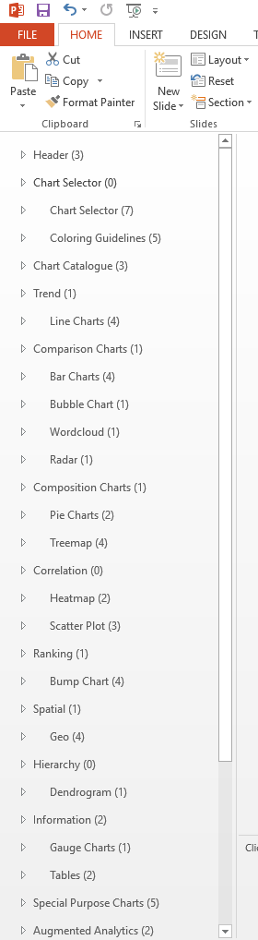
Chart Selector Catalogue
This catalog is organized using section headers in the slide navigation.
You can start with the purpose (e.g. comparison) and the indented list below it will show applicable charts
Not all chart types are listed at the moment (e.g. Column chart is not listed as Bar chart is pretty detailed)
Here is the high level categorization of charts:
Common purpose charts (Comparison, Composition, Distribution etc.)
Special purpose charts (Pareto, OHLC, Gantt etc.)
Augmented Analytics features (conversational analytics, automated insights)
Custom charts (data flows)
Marketplace charts

Slide 20
Chart Selector Catalogue
The slides in the remaining part will help you
Find charts by categories
Guidelines on when and when not to use
Common Do’s and Don’ts when using the chart
Variants of the charts
Other related charts

Slide 21
Charts for Trend

Slide 22
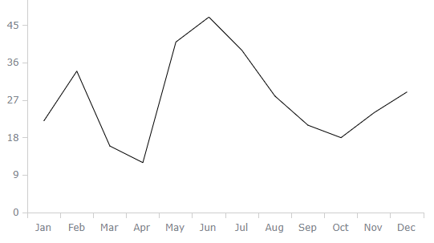
Line Chart - Summary
Shows: Trend, Comparison
When to use:
Plotting a time series to visualize how metrics are performing over time
Can be used for other categorical (discrete) data on x-axis as well but should be avoided.
Some continuous dimensions like Age, Speed, Levels may also demand line chart but should be used with caution
Lines can represent Dimensions or Measures
Metrics (Sales, Profit)
Category values (North Sales, East Sales, West Sales for Sales on Geo dimension)
 | Number of Dimensions | Number of Measures
Standard | 1 | 1
Extended | 2 | N
Extension Options | Stacking (category lines) | Add Series Dual Axis Labels Tooltips Combination
Variants:
Spline Chart (a "smoothened" line chart)
Sparkline (a line chart without axes and generally embedded in table cells or other visuals)
Step Line Chart
Jump Line Chart
Area Chart
Stacked Area Chart
Combination
Pareto
Do’s and Don'ts:
Avoid plotting non-time dimensions on the x-axis (category axis)
The vertical (y) axis can start mid-scale (instead of 0) as line points are used mostly for trending rather than magnitude.
If and when this is done, the axis scale should be kept dynamic (esp. when using filters on the dashboard)
Avoid using dual-axis line charts as the relationship between the metrics may be interpreted incorrectly
If absolutely needed, then ensure their scales start from zero (or the absolute base of the metrics).
Notes:
Extensions / Variants:
None of the below variants/extensions are recommended for Bar charts as their readability is reduced. If required, better go for Column chart if possible.
All the important information is kept handy in this single slide.

Slide 23



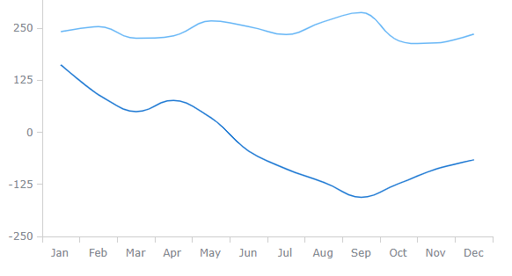
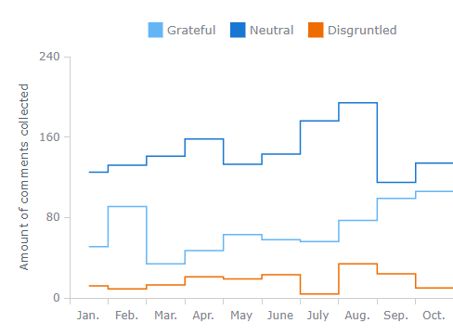
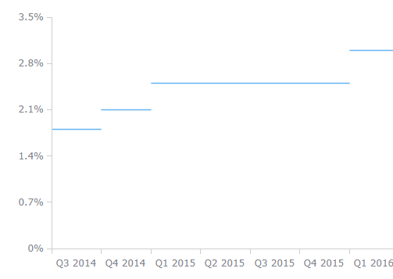
Line Chart Variants – Basic
Basic Line Chart
Spline Chart
A simple line chart showing variation of temperature over months. Lines charts are basically points connected by lines. The lines are actually drawn between the points – making them look like trend.
A spline chart is a smoothened line chart (points are connected by smoothened line instead of a straight line). In this case, we can see two lines – which can either represent two measures or two categories of a dimension. A spline takes freedom to plot the curves between the points and may reveal wrong pattern in very close comparisons.
Stepped line chart
Jump Line Chart
A stepped line chart connects the points using only perpendicular lines – there by clearly offering to see the variation between two points by the step size. It also helps to compare variation between multiple points. Generally used with multiple series.
A variant of the stepped line chart without the vertical lines. It essentially shows the duration for which the metric was constant. A new line appears when change occurs.

Slide 24
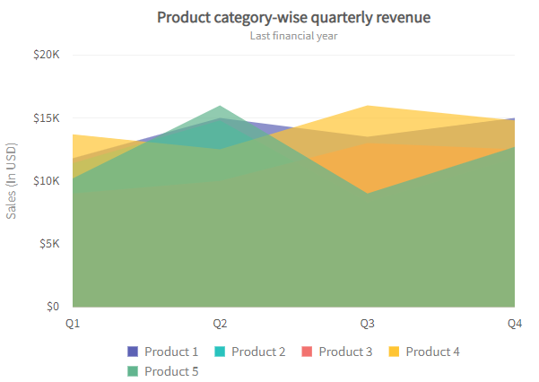
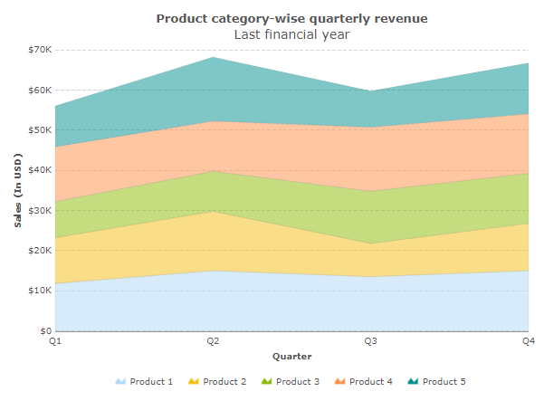
Line Chart Variants – Basic
Overlapping Area Chart
Stacked Area Chart
An area chart is a much like a line chart but with area filled thereby allowing for visual comparison of multiple series. It may or may not work in all scenarios – highly dependent on the amount of overlap between the series. An area chart should generally not be used if we need to plot a single series.
A stacked area chart also shows multiple series – but they are stacked on top of each other. Just like stacked bar/column, the interpretation of the stack should be based on the range rather than starting from 0 or base value. A percentage stacked area chart can also be used when percentage (composition) needs to be showed instead of the actual values.
Notes:
Stack Chart – Important Instruction:
Individual stacks should never be read solely on the basis of y-axis position. They need to be measured based on the stack size – from start of the stack marker to the end of the stack marker. They are composition of the full area.

Slide 25
Trend Charts - See Also
While Line Chart is the most common chart type for trending, the following charts are also related to time series or time plotting:
Sparkline Chart
Gantt Chart
OHLC Chart
Candlestick Chart

Slide 26
Charts for Comparison

Slide 27
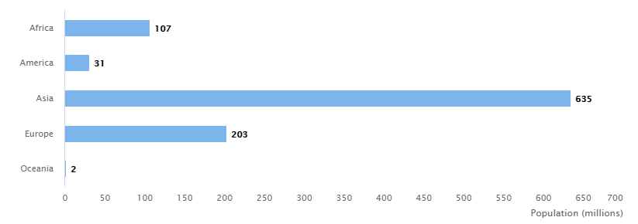
Bar Chart - Summary
Shows: Comparison, Composition
When to use:
Simple visual comparison across categories
Longer values on x-axis (in Column chart they affect looks when wrapped e.g. “North America – Professional Services”)
Large number of category values (chart height can increase along page length)
When time dimension with large number of data points needs to be charted, prefer line chart over bar/column.
 | Number of Dimensions | Number of Measures
Standard | 1 | 1
Extended | N | N
Extension Options | Stacking Clustering Combination | Dual Axis Clustering Bar Width Labels Tooltips Combination
Variants:
Clustered (Grouped) Bar Chart: Shows multiple measures (bars) clustered together for every category value
Variable width bar chart: Width of the bars represented by a different measure
Stacked Bar Chart: The measure bar shows composition by another dimension using stack
Radial Bar Chart: Shows bar in circular (radial) form
Rounded Bar Chart: Corners of the bars are rounded
Combination Chart: Bar charts are generally combined with line charts on primary/secondary axis
Do’s and Don'ts:
Always Sort/Order the chart
E.g. Sales Amount by State chart -> Order on Sales Amount (y-axis is sorted)
E.g. Employee Count by Level (L1,L2 etc.) -> Order on Level (x-axis is sorted)
Avoid starting the y-axis mid-scale (always start from 0)
Hide marker lines for increasing visual aesthetics
When spacing constraints, either hide bar value labels or y-axis labels (or both if out of space)
Do not use bar chart for dimensions involving continuous values e.g. Time, Speed, Age
They can still be used if these are in discrete form like showing data by Quarter, YoY/QoQ, Bins etc.

Slide 28
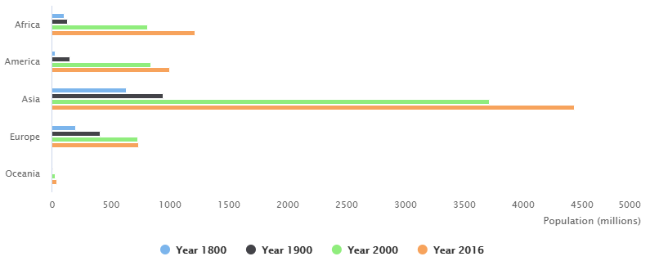
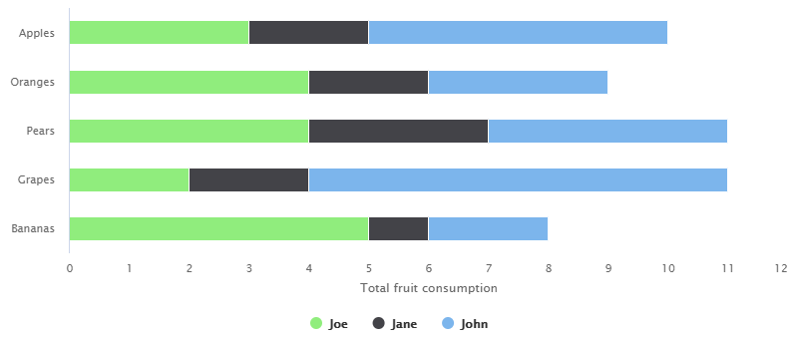
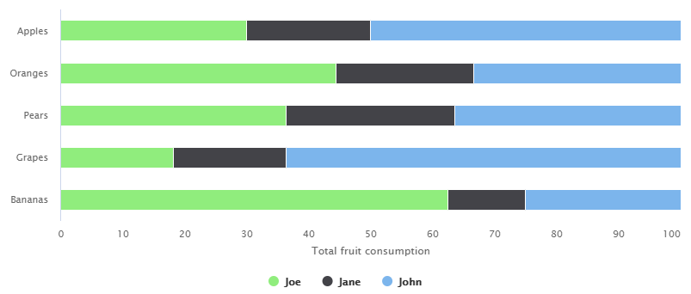
Bar Chart Variants – Basic
Bar Chart
Clustered / Grouped Bar Chart
A simple bar chart showing country wise population. Notice the population is in millions. This one is alphabetically sorted on category axis.
Each colored bar in the clustered set represents a year in the Year dimension. Similarly, each bar can also represent a measure.
Stacked Bar Chart
Stacked Percentage Bar Chart
Each colored stack mark shows a value in the Person dimension. Stack marks have a special interpretation. E.g. Jane consumes 1 Banana (not 6) as per the above chart. She also consumes 2 Apples.
This is similar to stacked bar chart but it shows percentage instead of the actual figures.
Notes:
Stack Chart – Important Instruction:
Individual stacks should never be read solely on the basis of y-axis position. They need to be measured based on the stack size – from start of the stack marker to the end of the stack marker. They are composition of the original bar.

Slide 29
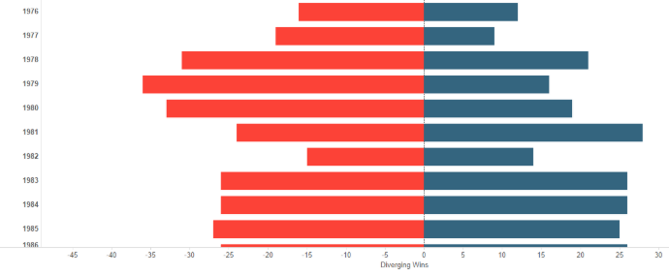
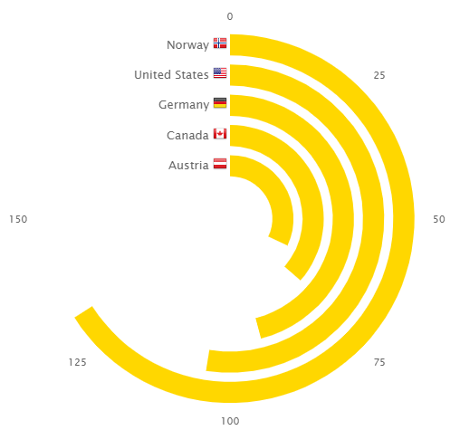
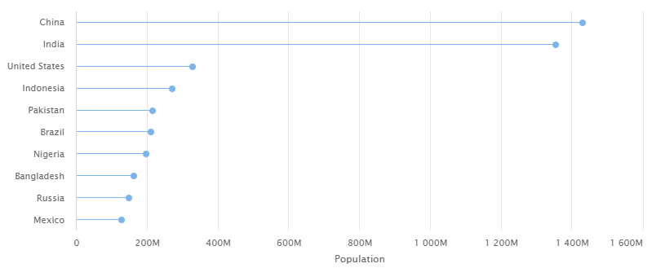
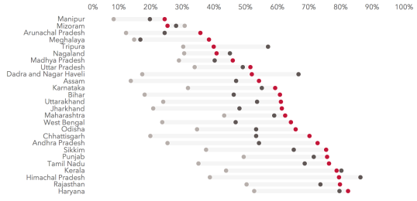
Bar Chart Variants - Extended
Bar with Negative Scale
Radial / Circular Bar Chart
Bar charts can show negative values as seen in this one.
A radial bar shows circular radials instead of straight line bars. This should not be confused with a multi-level pie chart that shows composition while this is comparison.
Lollipop Bar Chart
Range Bar Chart (not Gantt)
A Lollipop bar chart is a face lifted bar chart – the bars are thinned to a line while also attaching a candy on the top. The shape/size/color/image of the lollipop mark can be changed as required to show additional dimensions/metrics.
A range bar chart shows range of values – much like a stacked one but only with relevant series data.
Notes:
Lollipop Chart: The circle marks can be replaced with any other shape (column, diamond, star) or image (logo, flag etc.).
These charts can be further stacked to show their composition (e.g. stacked radial chart, butterfly chart).
Range Chart is different from Gantt Chart. Generally, in Gantt Chart, the bars can be repeated on the same line as in project management a person can work on the same task for different discrete time periods. Also, in Gantt Chart there are other markers such as Milestones, and it is always plotted on time axis.

Slide 30
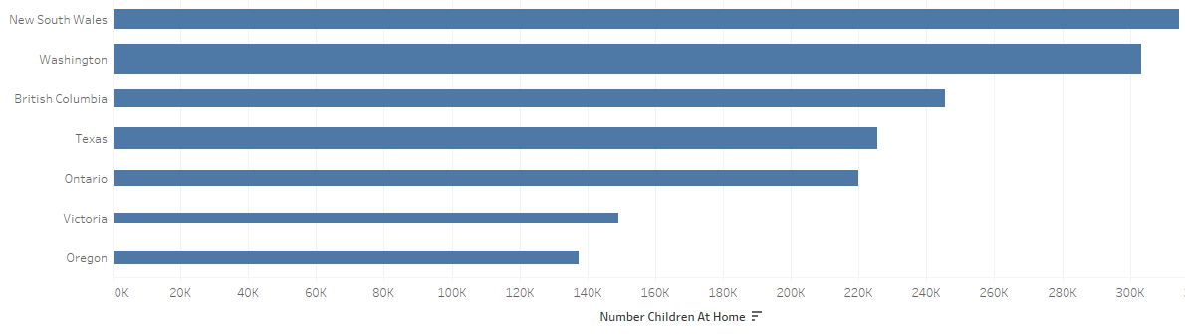
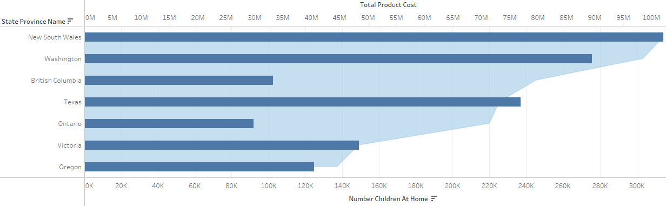
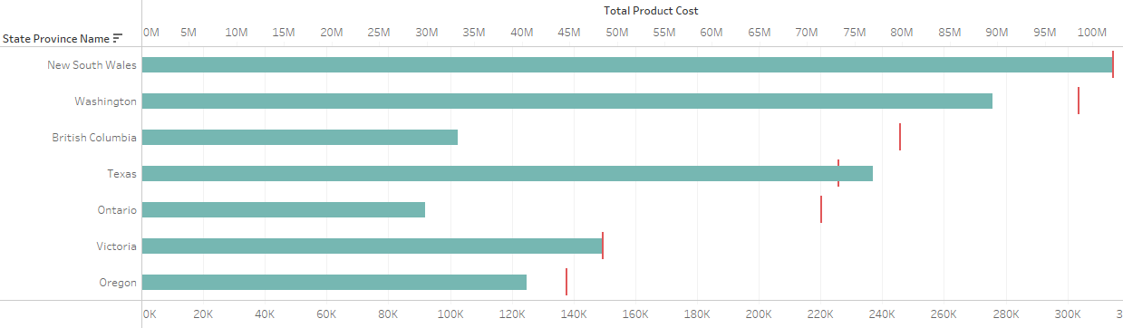
Bar Chart Variants - Extended
Variable Width Bars
Combined Bar and Area
In this bar chart, the width of bars changes are per another measure.
This is a combination chart – bar combined with area on a dual axis (secondary axis).
Bar with Bullet
See Also:
Gantt Chart
Column Charts
Histogram
This is also a combination chart live above – but instead of area/line, it shows a bullet mark. This bullet mark could have taken any shape – circle, diamond etc. but the simple bullet line makes it look like a “target” to achieve.

Slide 31
Bar vs. Column Chart
A “Bar” chart has horizontal bars while a “Column” chart has vertical columns
Column charts are more widely used than Bar charts but some selection criteria should be followed before finalizing one. Here are some tips:
Bar Chart preferred when… | Column Chart preferred when…
Horizontal space is available | Vertical space is available
Bullet combination | Histograms, any combination chart
Negative & Positive values | Positive values
Fixed bar width | Varying bar width
Large number of categories | Small number of categories
Any size axis-labels | Smaller category value length (x-axis labels)
Sorting on measure (y-axis) | Soring on any axis

Slide 32
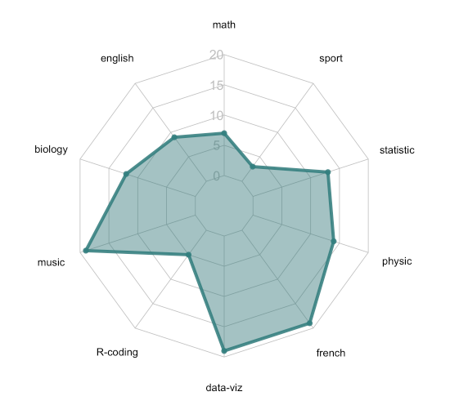
Polar/Radar/Spider Chart - Summary
Shows: Comparison
When to use:
Relative comparison of two dimensions on a common measure scale
Dimensions - One on web and other on line/area
Measure – Points on the web
 | Number of Dimensions | Number of Measures
Standard | 2 | 1
Extended | 2 | 1
Extension Options | None | None
Variants:
Line
Area
Do’s and Don'ts:
Order of the categories changes the visual altogether – determine the correct order forehand

Slide 33
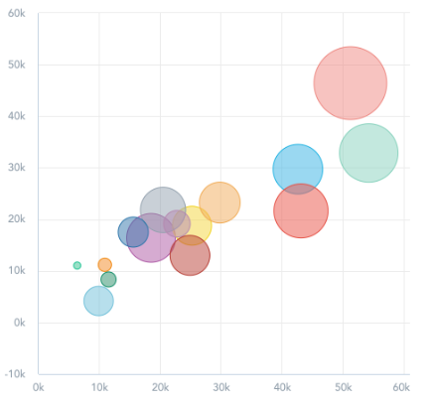
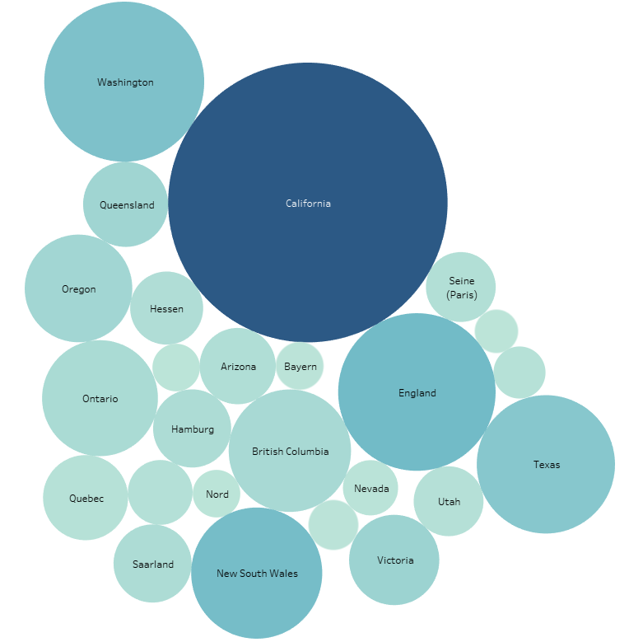
Bubble Chart - Summary
Shows: Comparison, Distribution
When to use:
Refers to two charts:
Free-form Bubble Chart
Bubble plot
Free form Bubble chart
Free-form visual comparison of one or more dimensions
Is a casual presentation chart – no axis
Placement of bubbles may change with change in data, magnitude, filters etc. – fixed form and size should not be assumed
Bubble plot
Plotted on a x-y axis (much like scatter)
Plotted on Geo map (Bubble map)
 | Number of Dimensions | Number of Measures
Standard | 1 | 1
Extended | N | N
Extension Options | Color | Size Color Labels Tooltips
Do’s and Don'ts:
Avoid too many categories / colors
Use Labels where possible
Free form – means it can change – what you see may not always be what you get
Variants:
Bubble Chart
Bubble Plot (x-y plot)
Bubble Map (on Geo map)
Bubble Plot
Free-form Bubble Chart

Slide 34
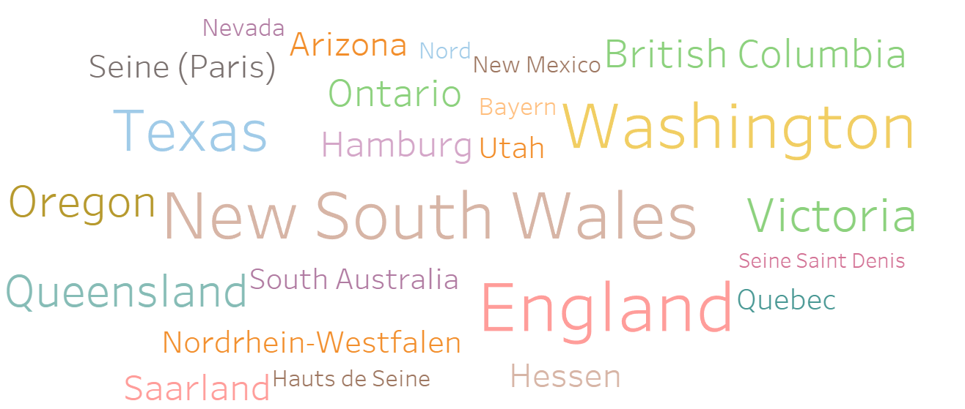
Word Cloud - Summary
Shows: Comparison
When to use:
Casual presentation – exact measurement not required
Categories fluctuate often and need to be clearly visible without much importance to variation in magnitude
 | Number of Dimensions | Number of Measures
Standard | 1 | 1
Extended | N | 2
Extension Options | Add categories Color | Size Color
Variants:
Size
Color
Do’s and Don'ts:
Use only when casual comparison is sufficient
Show metrics in tooltips

Slide 35
Charts for Composition

Slide 36
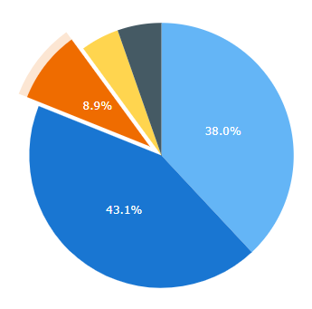
Pie Chart - Summary
Shows: Composition
When to use:
Simple visual composition as pies in a circle
When we need to emphasize contribution to the whole
Suited for small number of categorical values (dimension values)
Despite being a small data chart, generally takes a lot of space when legends are enabled
Use of Pie charts is rather disputed as it causes distortion in the dashboard design and human eye is not very good at estimating area (when compared to Bars).
Does not work with negative values (shapes cannot have negative size)
 | Number of Dimensions | Number of Measures
Standard | 1 | 1
Extended | N | 2
Extension Options | Repeat Pies Add Layers | Pie Height Labels Tooltips
Variants:
Doughnut Chart: A pie-chart with a hole that is more popular than the original pie now.
Semi-circle Donut Chart: Goes by the name and looks similar to gauge chart – but can have any scale unlike gauge chart which prefers 0-100% scale.
Variable Radius Pie Chart: Size of the pie slices are varying based on another metric.
Sunburst Chart: A layered donut with each layer showing one dimension.
Polar Area Chart: A combination of sunburst and variable radius pie that has multiple layers and varying pie size
Do’s and Don'ts:
Add data labels as there is no axis on this chart
Values on Pie
Category names outside the pie (if not supported then Legend)
Sort/Order the chart if there are a handful of pies. For larger number of categories that require labeling, the sorting can be avoided.
Merge smaller values in “Other” category
Aggregable measures should be used for pie size (e.g. avoid using rates, ranks, individual percentages)
Avoid using Pie charts for comparison (they are best suited for composition)

Slide 37
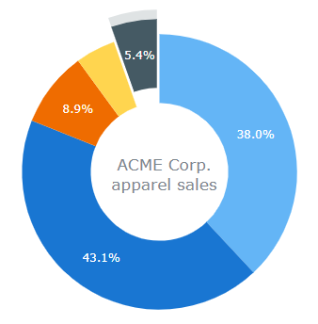
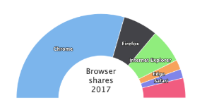
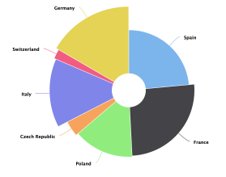
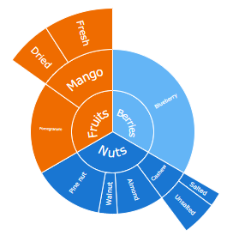
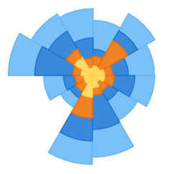
Pie Chart – Extensions / Combinations / Similar
Pie Chart
Donut Chart
Semi Circle Donut
Variable Radius Pie
Sunburst Chart
Polar Area Chart

Slide 38
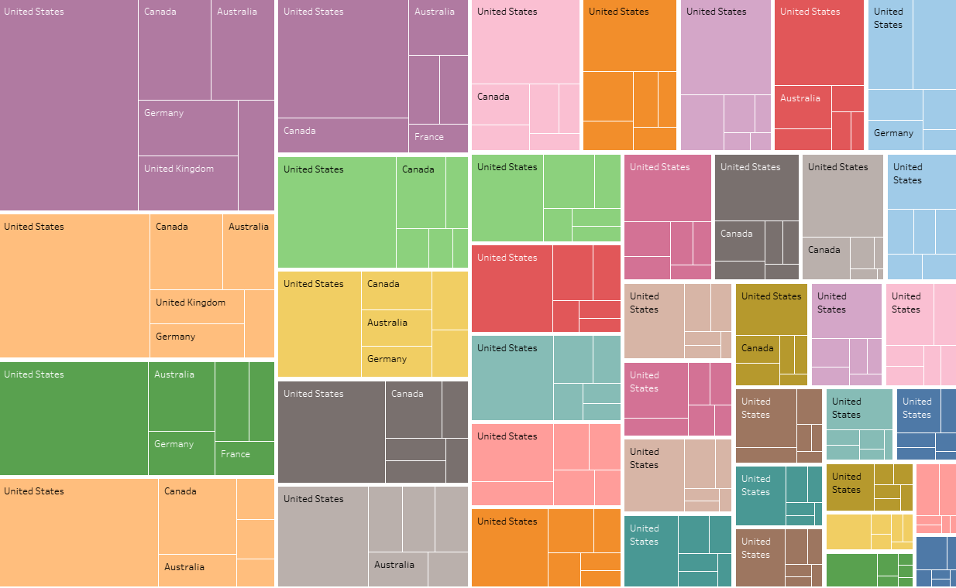
Treemap - Summary
Shows: Hierarchy, Composition, Comparison
When to use:
At-a-glance big picture to see hierarchical composition using nested rectangles that seem like branches and sub-branches – hence called Treemap
Suited for visualizing large number of hierarchical values in constrained space. Also for determining ratio of each part to the whole.
Comparison of Hierarchies (E.g. Product Category > Product > Sub Product)
Comparison of multiple dimensions (E.g. Region, Product Category)
Can show two measures (one for size, one for color)
As this is a composition chart, does not work with negative values for the size measure (color measure can be negative)
Too much magnitude difference (one with thousands, other in billions) does not work well too
 | Number of Dimensions | Number of Measures
Standard | 1 | 2 (Size, Color)
Extended | N | 2 (Size, Color)
Extension Options | Add Branch | Labels Tooltips
Do’s and Don'ts:
Do not plot measures that can have negative values on the size feature (e.g. KPIs that seem positive when looking as a whole but resulting in negative values when filters are applied)
Use tooltip based labels extensively in treemap as showing all labels is not feasible
Avoid going deeper than 3-4 dimensions unless necessary. When required, see if the lower metrics can be combined into a “others” category – so the chart is more readable.
Variants:
Single dimension tree map - looks flattened
Multi-dimensional tree map - looks hierarchical
Colors can also be used to represent an additional measure like in a heatmap
Colors can also be used to represent different dimensions

Slide 39
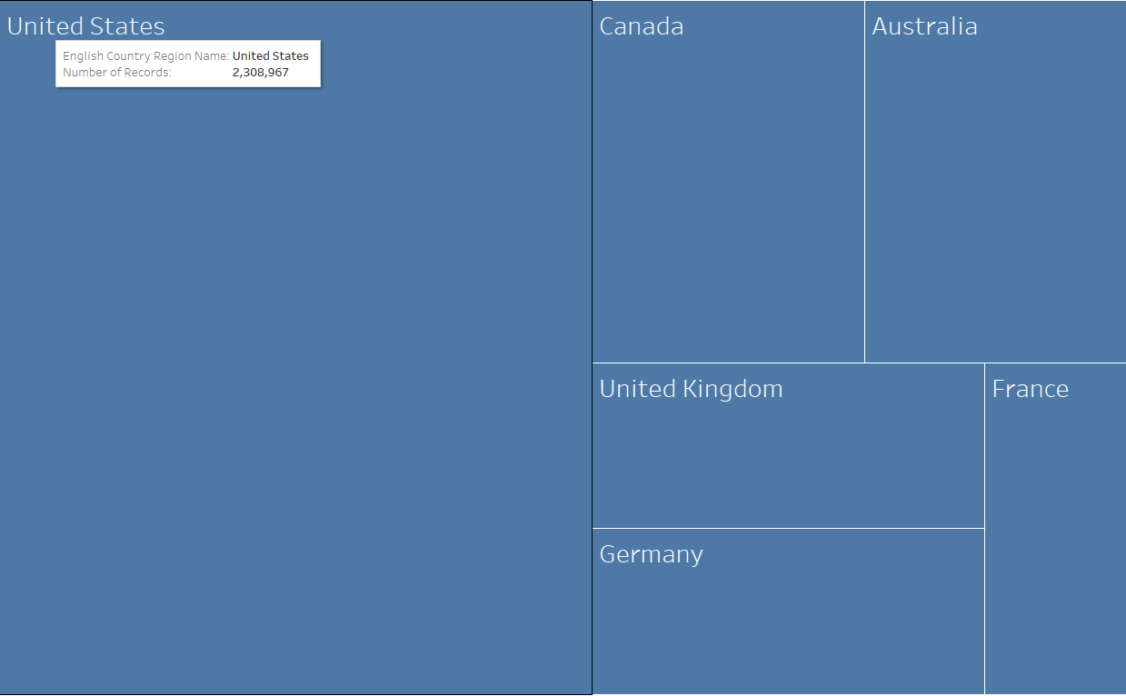
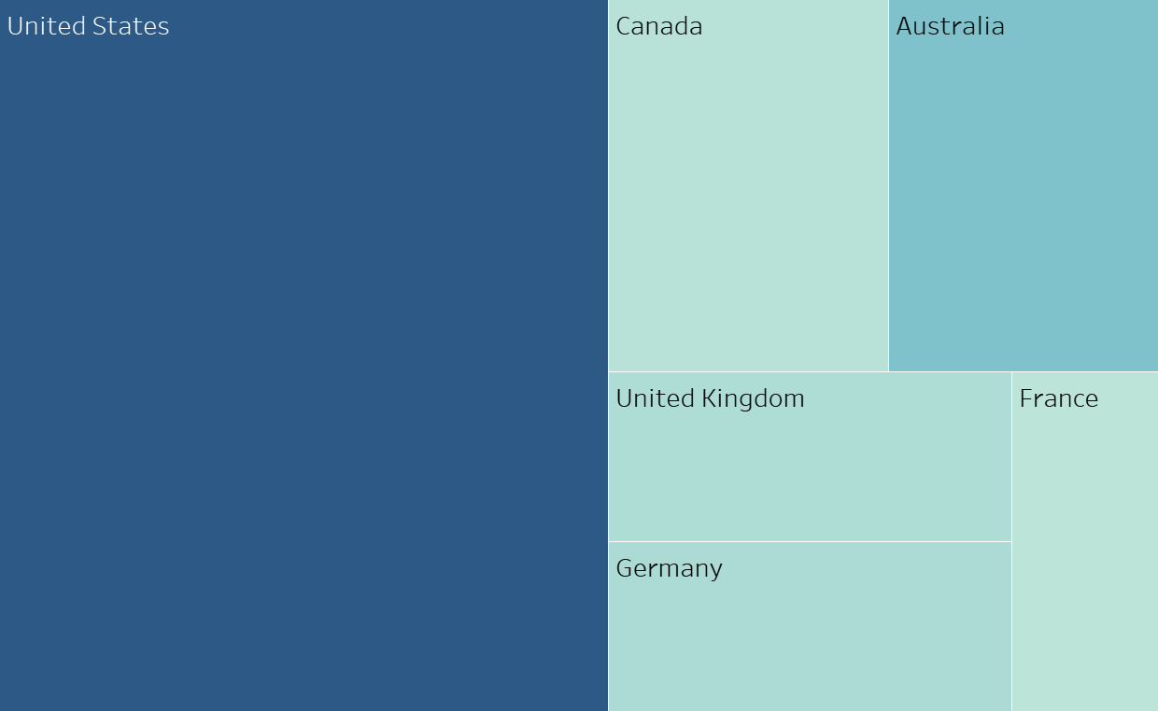
Treemap – Extensions
Treemap with 1 dimension and 1 measure
Treemap with 1 dimension and 2 measures
Each of the rectangles (leaves) represents a country; The size of the rectangle represents the Sales. Sales should not be negative here.
The one additional measure (Profit) drives the color of the rectangle. Profit can be negative as colors can be shown for that.

Slide 40
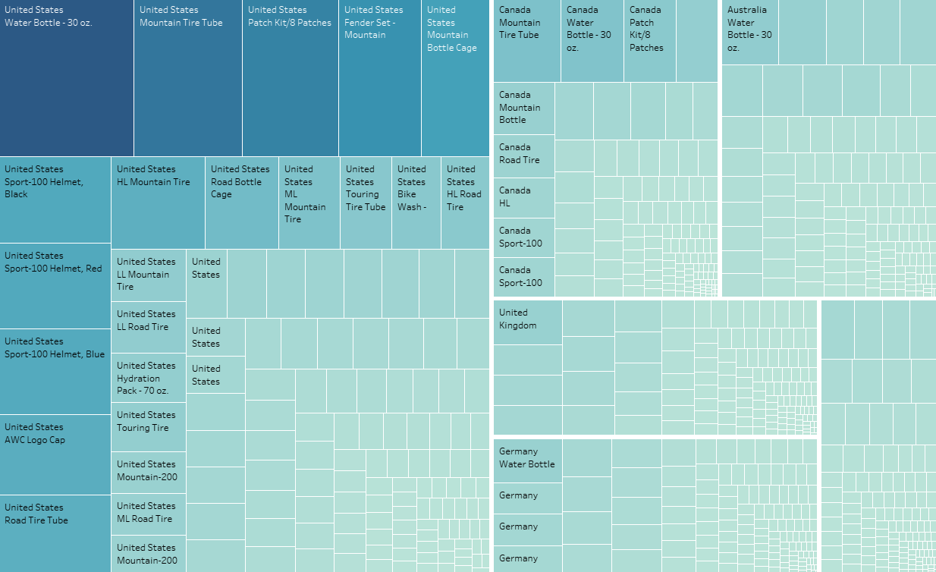
Treemap – Extensions
Treemap with 2 dimensions and 1 measure
Treemap with 2 dimensions and 2 measures
Each branch (cluster of one color set) represents 1 dimension – product in this case. The inner rectangles represent Countries. Size represents the Sales (for specified country and product).
Here the two measures are represented by Size of the rectangle and color. The two dimensions are the represented by branches and the leaves within the branch. Similarly, any number of dimensions can be added resulting in a branch, sub-branch hierarchy.

Slide 41
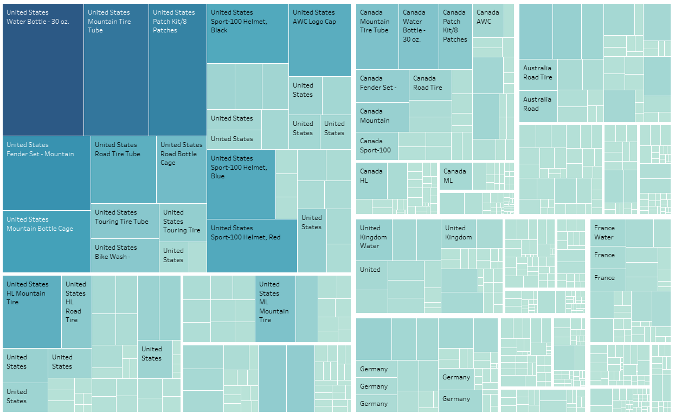
Treemap – Extensions
Treemap with 5 dimensions and 2 measures
Each Branch can be seen to be having sub-branches and they further have sub-branches. Readability is affected with such increasing number of branches esp. if they contain a large set of categories.

Slide 42
Charts for Correlation

Slide 43
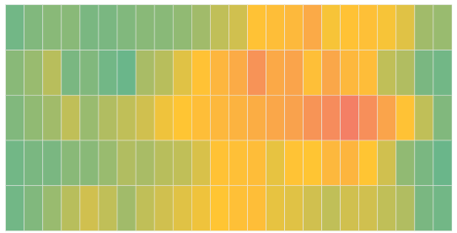
Heatmap - Summary
Shows: Correlation, Clusters/Outliers
When to use:
Compare two dimensional data (matrix) on a variable/measure.
Colors at the intersection denotes the intensity / magnitude of the measure.
Heatmap is often confused with Treemap. Both are completely different from each other. See the comparison slide that follows for differences.
The measures to be shown can be continuous (sales amount) or discrete (rank, rating) nature.
When two measures need to be compared, use a scatter plot. If there is an urge to use heatmap with measures on both the axes, convert the measures to bins and plot them on the heatmap.
 | Number of Dimensions | Number of Measures
Standard | 2 | 1
Extended | N | 2
Extension Options | Add additional dims on any axis | Color Size Tooltips
Do’s and Don'ts:
Avoid more than one dimension on each axis (though technically possible)
Variants:
The size of the intersection cell can be used to represent a second measure in heatmap
Geographic Heatmap (see Spatial section)
Using measure bins on both the axes to get a scatter like histogram

Slide 44
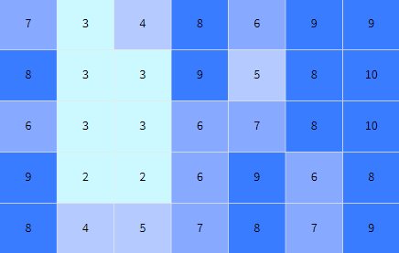
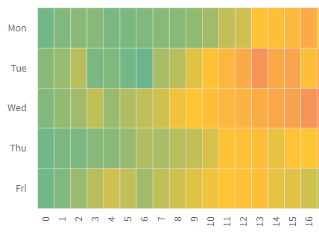
Heatmap Variants
Heatmap on discrete measure
Heatmap on continuous measure
A heat map with movie name on x-axis and reviewer name on y-axis. The discrete measure here represents the rating for the movie by the reviewer. Showing this information in crosstabs or heatmaps allows for condensed display in a small space.
This heatmap shows weekday on one axis and hour of the day on other. The continuous measure is the average temperature of a component during the particular day/hour. Helps easily identify hotspots and greenzones. Finding patterns is very well done by heatmaps.

Slide 45
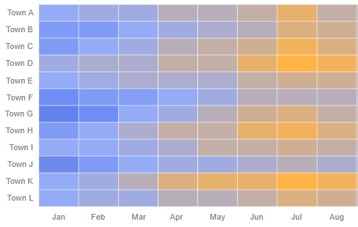
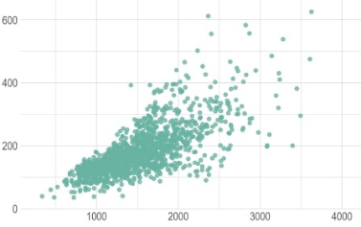
Treemap vs Heatmap vs. Scatter Plot
Treemap | Heatmap | Scatter Plot
Does not have axes | Plotted on axes | Plotted on axes
-- | Dimensions on x and y axes | Measures on x and y axes
Purpose: Composition, Comparison | Purpose: Correlation, Comparison | Purpose: Correlation, Comparison
Suited for Hierarchical Data | Not suited for Hierarchical Data | Not suited for Hierarchical Data
Suited for multiple dimensions | Not suited for multiple dimensions | Suited for multiple dimensions

Slide 46
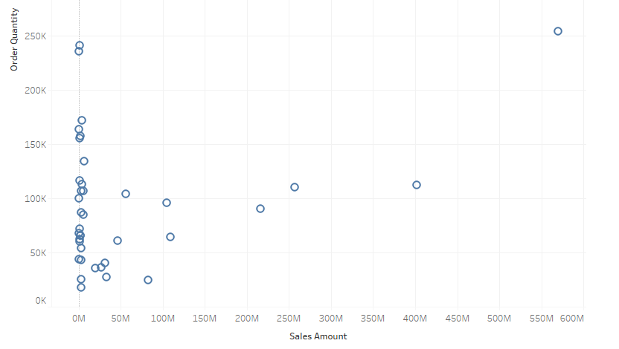
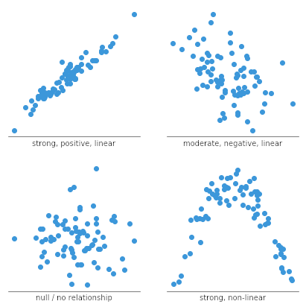
Scatterplot - Summary
Shows: Correlation, Clusters/Outliers
When to use:
Find relationship between two measures (variables)
Helpful for finding clusters or outliers
Generally used once-a-while for analysis rather than daily – unless data is very volatile or outliers need to be spotted when occurred
 | Number of Dimensions | Number of Measures
Standard | 1 | 2
Extended | 3 | 3
Extension Options | Color Shape Size | Color Shape Size
Variants:
Color
Size
Shape
Relationship patterns:
Do’s and Don'ts:
Avoid more than one dimension on each axis (though technically possible)

Slide 47
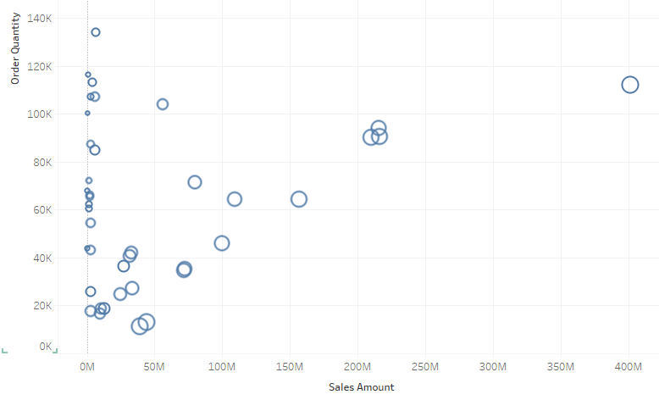
Scatter Plot - Variants
Scatter Plot
Scatter Plot with mark size
A scatter plot showing products (circles) based on the sales amount and the quantity. Unlike usual convention, the top-right most circle represents a product (mountain bike) which has sold highest.
The size of the circle in this plot represents additional measure (cost of the product). The top-right circle represents a product that is fairly costly but still sold the highest – indicating a very popular product. It can also be an outlier – possibly suggesting a data issue.

Slide 48
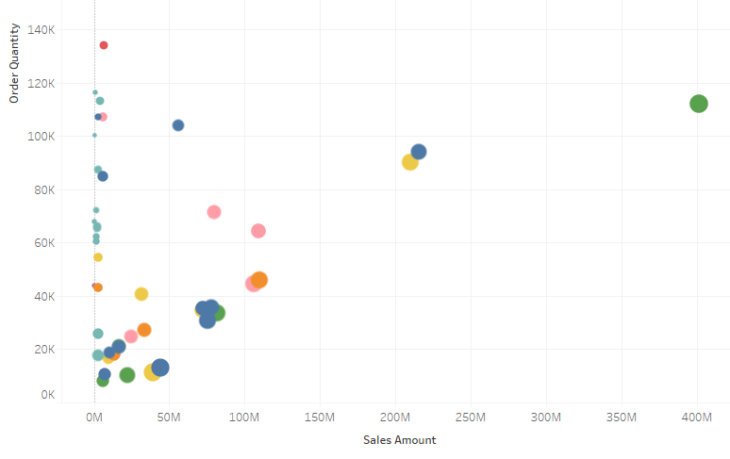
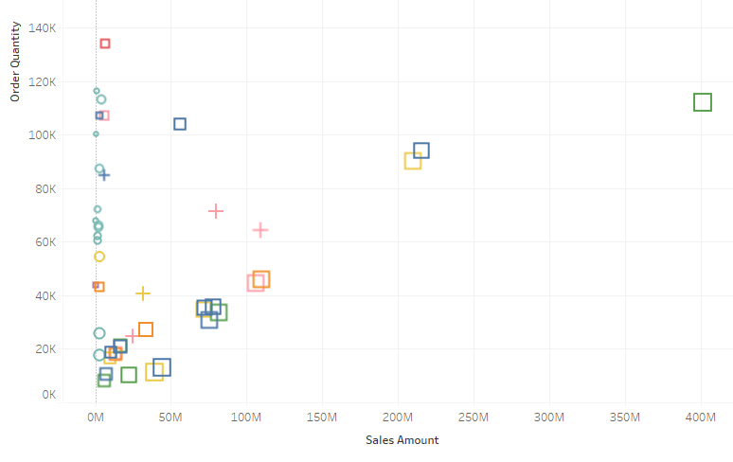
Scatter Plot - Variants
Scatter Plot with mark size and color
Scatter Plot with mark size, color, and shape
In this scatter, an additional dimension is shown using the color of the mark. In all, we have 3 measures (x, y, size) and 2 categories (point, color) shown in this scatter.
The shape of the marks represents an additional dimension taking the count of dimensions to 3 in this scatter.

Slide 49
Charts for Ranking

Slide 50
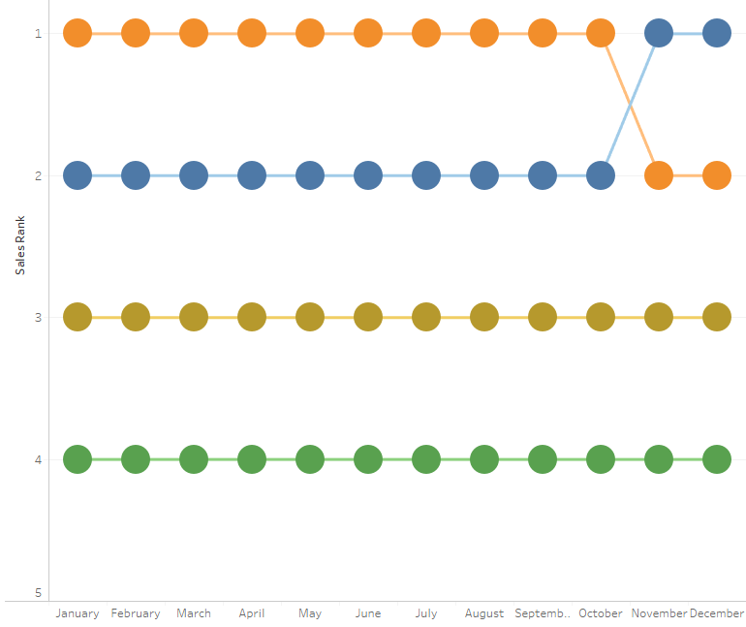
Bump Chart - Summary
Shows: Rank Variation
When to use:
Bump Charts is very similar to line chart but instead of showing aggregated measures, they show variation in rank over time.
The variations in rank over the selected time period should not be too high – else the chart may look knotty.
Suitable for a small number of categories (5-10) as too many lines may not make it readable. If higher number of categories in data, group the smaller ones in “Other”.
Purely showing bump marks hides the magnitude (measure amount determining the rank) completely. Showing magnitude may add further complexity in readability.
The chart may have wild variations when filters are applied – better to test or make it immune to filters.
 | Number of Dimensions | Number of Measures
Standard | 1 | 1
Extended | 1 | 3
Extension Options | None | Line Size Circle Size
Do’s and Don'ts:
Increase the size of the chart to enhance it’s readability – more space leads to clearer line movements.
Make sure you check the magnitude thoroughly – if the variation is too small, ranks may well do injustice to the data being visualized.
When grouping smaller categories in “Other” category, their individual and composite rank should be compared esp. with filters.
Variants:
Bump Chart
Area Bump Chart
Size variations of dots
Size variations of lines

Slide 51
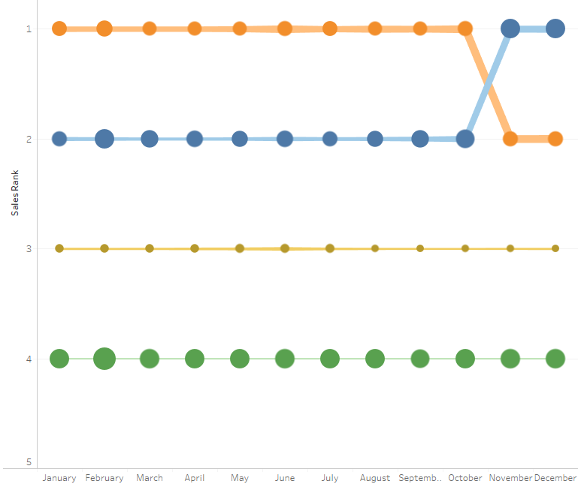
Bump Chart – Extensions
Bump Chart
Bump Chart with size variations
A basic bump chart showing rank variation over time. Top line is rank #1 while each color represents one category.
Two additional measures shown by line size and circle size
Notes:
Tableau Visual of the Year (2016):
https://public.tableau.com/profile/matt.chambers#!/vizhome/CarColorEvolutionNorthAmerica/ColorRankOverTime

Slide 52

Bump Chart – Extensions
Bump Chart with size variations

Slide 53
Charts for Spatial Data

Slide 54

Geo Maps - Summary
Shows: Spatial
When to use:
Geo/Location/GIS (latitude/longitude) data is available and needs to be visualized
Visual hints over exact numbers are acceptable
Users should be aware of the geography (when using not so common locations)
 | Number of Dimensions | Number of Measures
Standard | 1 | 1
Extended | 2 | 2/N
Extension Options | Combination (Bubble, Pie) | Color/Dot Size of mark Labels Tooltips
Variants:
Dot Map
Bubble / Pie Map
Choloropleth Map
Flow Map
Hex Map
Heat Map
Do’s and Don'ts:
Always check the availability of map, data mapping for all the data being used (including drills).
Maps are generally available at State level for most countries
When using lower grain data (e.g. City), ensure higher level categories are also available in geo data mapping to avoid duplicates (same city being available in two different states or countries)
Disputed boundaries / international boundaries may not be acceptable in certain countries – local variant should be used.
When used for government/legal purpose, ensure all geo limits are also covered (e.g. islands, un-connected areas, disputed areas)
E.g. Alaska in US is generally ignored as it does not have a common boundary with the rest of the US.

Slide 55


Geo Map – Extensions
Dot Map
Bubble Map
Pie Map
A dot on the map shows the metric (for a state in this example)
Circles instead of dots provide visual comparison of the metric
A pie-map combination chart. Notice the size of the overall pie and also the slices within.

Slide 56


Geo Maps – Extensions
Filled Map (Chloropleth)
Hex Map
This filled map has state with colors representing the metric
A custom chart variant, hex map provides simple and clearer representation of the constituent states. This may not be readily available – needs to be customized.

Slide 57

Geo Maps – Extensions
Geographic Heat Map
A real (traditional) heat map – showing continuous colors for varying intensity. When location / latlong data is available, scatters (dots) can be plotted to show similar heatmap on geo maps.

Slide 58
Charts for Hierarchies

Slide 59

Dendrogram / Decomposition Tree - Summary
Shows: Hierarchy, Tree, Decomposition, Distribution
When to use:
Show hierarchy
Interactive decomposition on hierarchical values
Show decomposition of non-related dimensions as well (not in hierarchy)
Visual drill-down like functionality needs to be achieved
 | Number of Dimensions | Number of Measures
Standard | N | 1
Extended | N | 1
Extension Options | Add dimensions
Do’s and Don'ts:
Generally keep this visual in its own tab / sheet – drill down requires screen state
Define the drill down dimensions or hierarchies

Slide 60
Charts for Flow

Slide 61

Sankey Chart
Shows: Flow
When to use:
Show flow of any metric (e.g. quantity) across stages
Hierarchical or unrelated dimensions
Small or large number of categories
One or multi-level flow
Linear or circular flow
Tool supports this chart type for the above scenarios
Generally, data modeling may be required
Suited for interactive analysis as values require hovering over the flows
Do’s and Don'ts:
Assess feasibility of developing this powerful chart – in terms of features, data, and outcomes.
This is a complex chart type and should be thoroughly evaluated before finalizing
User education may also be required

Slide 62
Information Widgets and Charts

Slide 63






Single Value – Cards/Tiles
Shows: Information, Comparison
When to use:
To show KPIs (Key Performance Indicators), Metrics Based on the features provided in the widget, it can also show
Single value summary with additional comparison like previous period
Sparkline / Area trend
Filling
Descriptive text
Multiple widgets used to create an informative section
Do’s and Don'ts:
Ensure the size of the main KPI number itself is larger than any other text in the card
Avoid too much clutter unless explicitly required
Use decimal places judiciously – for a $ value in thousands it does not make sense to show decimal places
Change/delta indicators (arrows) are a huge plus – ensure their colors (red/green/neutral) are aligned per the KPI

Slide 64





Single Value - Infographics
Shows: Information, Comparison
When to use:
Visually appealing dashboards or infographic based collaterals
Graphics are predominant over the metric/KPI itself
Customization options should be available (including external libraries)
Library of images are available (or could be created)
Do’s and Don'ts:
Use filled infographics (image is filled with a color to a level matching the percentage)

Slide 65



Gauge Charts
Shows: Information, Comparison
When to use:
To show a KPI/metric (preferably percentage) on a completion scale
Min/Max values of the metric should be known (either percentage or absolute number)
When non-percentage metrics are being used, ensure their scale remains the same when filters are applied
Do’s and Don'ts:
If using a color scale for marking high/low good/bad performance, ensure the colors are marked in context to the rating
Low values may not always be red (e.g. Count of Defects)
When a bunch of numbers need to be shown, prefer to go with Single Value cards/tiles instead of multiple gauge charts
Solid Gauge
Angular Gauge
Thermometer

Slide 66
Tables - Summary
Shows: Data/Information, Comparison
When to use:
Information over patterns
Detailed data over summarized info
Lot of attributes, dimensions and measures
Large number of rows
 | Number of Dimensions | Number of Measures
Standard | N | N
Extended | N | N
Extension Options | Add columns | Add Columns
Variants:
Pivot / Cross Tab
Scorecard
Inline Bars
Inline Sparkline
Conditional Formatting
Do’s and Don'ts:
Pay attention on formatting, alignment, column sequence, rows ordering (sorting), pagination etc.
Ensure all tables in a report have similar look and feel
Consider printing or PDF export scenarios when using scrolls

Slide 67


Table Variants
Table with Sparkline (area)
A table showing a sparkline area chart for every row. The sparkline shows a trend for last 6 weeks of the KPI being showed in the table.
Table with Conditional Color Formatting

Slide 68
Special Purpose Charts

Slide 69


Pareto Chart (80/20 rule)
Shows: Pareto Principle (Composition, Comparison)
When to use:
Pareto Principle (also called 80/20 rule, the law of the vital few)
For many events, roughly 80% of the effects come from 20% of the causes
This is more of an assumption than a law and should be used where applicable
Purpose:
Quality control (RCA)
Economics
Business
Do’s and Don'ts:
Use only where the principle is applicable (with accepted percentage deviation)

Slide 70

Funnel Chart
Shows: Distribution
When to use:
Visualize discrete stages in a process (E.g. very commonly seen for stages in a sales process)
Generally good for data which flows through a process and reduces as it moves on the stages - thereby making it look like a funnel. Examples below:
Business Scenarios:
Sales by stage
Recruitment stages
Orders pipeline
Promotional Mails
Do’s and Don'ts:
Label the stages – both with category and the value
Dynamically size the stage with the value

Slide 71

Gantt Chart
Shows: Project Schedule, Activities & Milestones
When to use:
Project scheduling
Attendance / allocation over time
Do’s and Don'ts:
Gantt chart is generally not used in dashboards – it has more of operational applicability
The structure may make it fit to use it for some other purpose – use it after proper assessment

Slide 72


OHLC and Candlestick Charts
Shows: Stock price (Open, High, Low, Close)
When to use:
Show Open, High, Low, Close values
Stock price variations
Do’s and Don'ts:
This chart can be used to show other metrics based on similar patterns (e.g. current, previous, min, max) but to be used with caution and user education as it may be confused with stock price. Box and Whisker plot can also be used in such cases.
OHLC Chart
Candlestick Chart

Slide 73
Augmented Analytics

Slide 74

Smart Analytics
Natural Language Interaction
Voice interaction
Gesture interaction
Automated Discovery / Insights
<more to be added>

Slide 75

Search / Conversational Analytics
Shows: Any chart (based on conversation)
When to use:
Natural Language Interaction
Conversational analytics
People oriented delivery over Data oriented delivery
True self-service but with simple requirements
Do’s and Don'ts:
Define Synonyms (on common field names) to simplify search
Know the synonyms that the tool supports and create the rest as per business verbiage
Define Aliases on data values for better search results
Know the aliases that business users are familiar with
Variants:
Search
Chat

Slide 76




Search Analytics in BI Tools
Power BI – Q&A
Tableau - Ask Data
ThoughtSpot - Search
Qlik – Insight Bot

Slide 77

Automated Insights / Discovery
Shows: Descriptive Insights
When to use:
Finding Influencers
Determining Root Causes
Finding Anomalies / Outliers
Revealing Indicators
Personalized recommendations
Machine recommended insights delivery

Slide 78




Automated Insights in BI Tools
Power BI – Key Influencers
Power BI – Decomposition Tree
Tableau – Explain Data
ThoughtSpot – Spot IQ

Slide 79
Custom Charts
Coming Soon…

Slide 80

Infographics in Tableau – by Hemang Bhavasar
Notes:
https://public.tableau.com/profile/hemang.bhavasar#!/vizhome/DiabetesDashboard_1/DiabetesDashboard

Slide 81
Marketplace
Coming Soon…

Slide 82
evolve.

